Slide 1
Hotel Management System
KDY_2020­_WD05

Slide 2
Introduction
Hotel Aronway is one of the most popular hotels located in Mawanella area among both national and international guests. The reason behind its popularity is the location as there is a nice river flow by and there are very popular tourist attractions nearby. Of this hotel, there are 15 rooms in three different styles are available to meet the needs of any type of traveler, while the food in their restaurant and bar will satisfy any palette. As well as finely featuring banquet facility has become one of the main reasons behind its popularity. At present, there are 45 employees working under 05 main departments of the hotel.
Currently, Hotel Aronway is doing its every function manually, such as taking reservations, updating room availability/function hall availability, recording guest details, guest meal plan details, status of rooms (clean, vacant, out of order or any other), maintaining inventories, personnel management and even billing. So, they are using documents for every function and keeping/filing records. They have to put an extra effort to secure their records as they need a separate space to store them for a long time, protect them from any damages like fire, insects, or any other disaster and some of the information is confidential as well. At the same time, it wastes the most valuable thing in an organization which is man-hours.
Earlier it was said that the most significant part of the hotel industry is associated with the human touch or it is labor-intensive. But today it is realized that hotel management systems play a significant role as equal to its human touch. The system we will be developing helps to overcome all the challenges that our client is currently facing.
It helps the client in their every day to day function. It would handle all the front desk activities (guest profiles, room types, room/function hall availability, room status), reservation details, guest meal plans, inventory management, personnel management, cashiering and other accounting functions.
All of the above information will be stored in the system database and can be reverted whenever needed. As well as, the interface will be designed user-friendly and functions will be displayed in a simple manner and will ensure that easy to learn. Switching to our system will save time, manpower, space wastage and ensure smooth operation in day to day activities and ultimately will help to achieve organizational goals and objectives effectively and efficiently.

Slide 3
Current way of handling tasks
Hotel Aron way, our client currently using a file-based system to maintain their hotel’s processors. Employees must write down every important records of the hotel to a piece of paper and keep them in a separate physical file. Which waste valuable man hours and puts the company’s data into a vulnerable state. Below are the problems which are faced by the client.

Slide 4
Problems and solutions
Time consuming
To find the relevant information. It will take much time to search documents in the cabinet. Sometimes some services go out next day such as delivery services.so that customers not satisfied about poor service. Using this system, they can provide quick and good service to customers and they can improve their productivity.
Higher cost and wastage
Every information in the company is stored in much papers.so that we need to buy ink, papers, cabinets and cupboards to store that documents. That Documentation and record keeping process is very costly in manual system. Using this system, they can reduce their expenses.
Record employees' details and attendance.
Using a file-based system have limited the ability of making changers on data. Employees’ salaries calculate based on their attendance. Therefore, hotel's management must record attendance of every employees. Using our system, they can easily add an employee to the data base and maintain their details. Also, they can easily take attendance of employees and calculate their salaries by using our system.
Calculate bills manually
Calculating bills manually take serious amount of time. We cannot always trust the accuracy of the manual calculation by reason of human errors. Moreover, keep track of income using manual bills is a challenging task. Our system will reduce employee's workload and will provide a reliable income report at the end of the month.

Slide 5
Problems and solutions
Keep track of inventories.
Inventory records are the most essential things to a maintain in a Hotel system. Using a file-based system to keep track of inventories produce miscalculations. Our system will provide user friendly interfaces to manage all the inventories in effective manner. Moreover, our system will detect items that are needed to be restored and will notify the corresponding employee.
Reservation overlap.
Current system of the hotel constantly leads to a reservation overlap among deferent customers due to poor data handling. Using our system, they can manage customers’ reservations in effective manner.
Lack of security
Employee’s data and Management data was being misplaced. That misplaced documents can easily take into wrong hands. If lost the documents somewhere, there is no chance to get them back. We are at risk of using manual system. By using our system, they can prevent unauthorized access to company information.

Slide 6
Benefits of the System
Managing Booking
Our system will automate the booking process for employees. Therefore, Employees can focus more on interact with guests. This will significantly reduce the over booking of rooms and halls, which directly improves guests’ experience at Arron way hotel.
Reduce time spent on management function.
This system will handle most of functions of the hotel which previously handle by manually. This will save manager’s precious time.
Generate Reports.
System generated reports will give a clear idea about the current status of the system, which will help management to take appropriate decision for the betterment of the business.
Efficient customer service.
This system can handle most employees’ works in efficient manner. This system will increase the productivity and provide the best service to the customer.
Store data in secure way.
System database can store the important information in secure way rather than using the paper documents. Nobody can change the data without having manager’s approval.

Slide 7
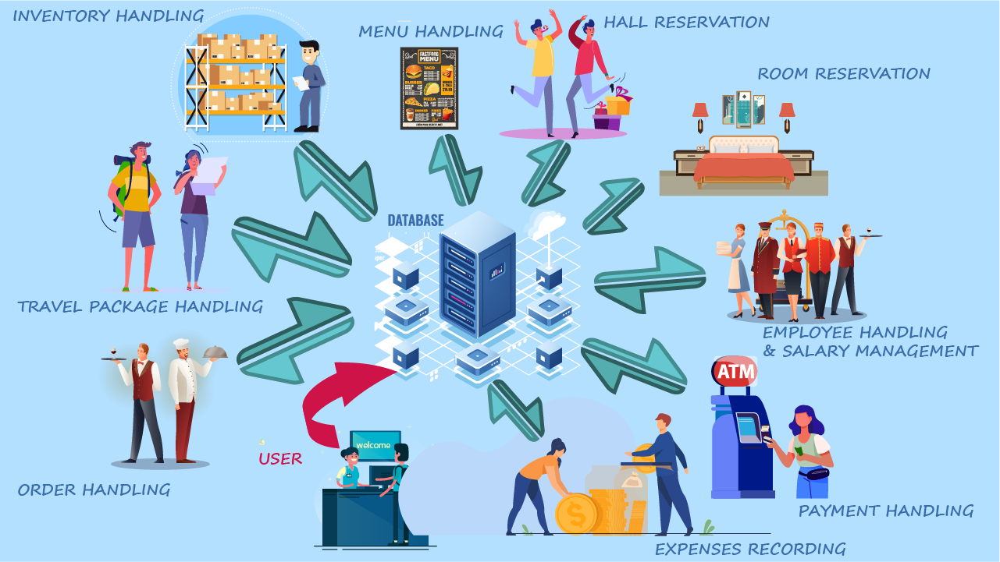
System over view diagram

Slide 8
System functions
Inventory management
The purpose of this function is to manage Items and ingredients in the inventory. The function mainly focuses on adding, updating and removing Item details from the system. The details going to store are Item code, Item name, and Available quantity at the current moment. The function also detects running out items in the stock. When displaying the inventory on the screen as a table, there is a column to input state whether an item needed or not in front of the item. This state is auto update according to the quantity item. In the function there is another data base table which is include category for the items and there is a attribute to input minimum available quantity which is one of attributes decide state attribute of the item table. There is also an operation to get a report of items that needed to restore soon. Also, the function gives a feature to get a report of highly used ingredients of a given month with used quantity.

Slide 9
System functions
Hall reservation
In this function receptionist can add new hall reservation into the system according to the customers’ willing. As details user is going to record reservation id, customer name, customer’s contact number, reserved date, hall number, menu id. Also, user can update an exist reservation details in the system. If customer wants to cancel the reservation the user can delete inserted reservation by using this function as well. If user want to get a report which is included details about the month with highest reservation, this function also provide a feature to do so as well.

Slide 10
System functions
Employee handling and salary management
This function holds all the details about employees. If a new employee join to the hotel as permanent, admin (manager or owner) can insert his or her details to the systems by using this function. Inserting details are employee id, employee name, employee NIC, date of birth, basic salary. Apart from inserting, user also can update and delete employee details by using features of this function.
For salary management user first get attendance of each employee manually. Then user enters those attendance count to system and calculate his monthly salary by using basic salary and attendance. User also get a record of the calculated each employee’s salary in each month and store the record in the database.
As additional features of the function, user can get a report, which output details about best employee of the month basic on attendance. Also user can get a pay sheet of a particular employee if the employee needed a one.

Slide 11
System functions
Room Reservation
Room reservation functions are main functions of the system. Admin can search for available rooms by giving customer requirements such as room type, number of adults and children. System will view available rooms and admin can choose a room. Admin fills room reservation form by giving customer details for place the reservation. If admin wants to edit reservation details, he can change room type, checkout date, number of adults and children. When customer wants to cancel the reservation, admin can delete the reservation from the system.

Slide 12
System functions
Order Handling
The order handling function mainly focused on how to handle the supply orders which are ordered to the hotel. Using this function manager can add new supply orders to the system, update the order when needed, and manager can delete orders when it is necessary. The manager receives a notification prior to the order receiving. The system will generate a report of the most expensive order for each month. A supply order contains details like order id, order title, item name, quantity of items, description. The interface is user friendly and easy for anyone to learn.

Slide 13
System functions
Payment
This function will provide an interface for admin to add credit/debit card details such as card number, expire date and cvv number, to the database along with the other payment details. Date and the time will get by the default functions and will be saved in the database with other payment details. By using this function, admin can modify the details which added previously. If needed admin can delete any payment details which are no longer required or useful. Moreover, this function will provide a report at the end of the month, comparing a particular month’s income with the previous two months.

Slide 14
System functions
Expenses Handling
This function is about expenses handling. After user login to the system user can check Monthly income and monthly expenses. And also can insert and remove the expenses details in Expenses list and Income list. If user included a wrong expenses details in to the system, he can delete those details can be deleted by using this function as well as. If user want to add expenses details in to the system, he can add or update those details can be add by using this function as well as. User can check total amount of expenses list and income list. Also user can check whether this mount is profitable or not.Details that are gone to store by the user is DateOfPayment, MethodOfPayment, PaidTo, Description, AmountPaid, Subtotal

Slide 15
System functions
Menus handling
Customer can select the food items he likes.
After that hotel manager or hotel owner can add that details to the system or he can update existing details or delete them.
After login to the hotel manager’s or Hotel owner’s account. He can click the Manage food menu button inside his profile.
After clicking on Add new menu button he can add a new food menu to the system.
If he wants to update a menu in the system he has to click on Update food menu button.
When he click on Update food menu he can search a menu using food menu ID .after selecting a menu the menu will display and manager can update it.
If he wants to delete a menu in the system he has to click on delete food menu button.
When he click on delete food menu he can search a menu using food menu ID .after selecting a menu the menu will display and manager can delete it.

Slide 16
System functions
Travel Package Handling
If user needs to reserve a travel package, he/she can use this function. In this function user can select wherever he wants to travel, how many days he wants to travel, travelling date, how many participations per travel, customer’s travel guider’s details… etc. Also, He needs to change travel details after adding, he can change his details. If he needs to cancel his booking, he can cancel anytime. Finally, user can generate a report of mostly prepared travel package of customers.

Slide 17
Technologies
Java
Netbeans
MySql Workbench
Github
Java Swing

Slide 18
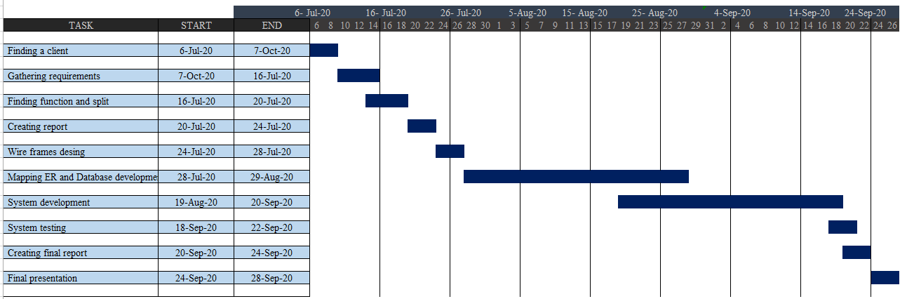
Gantt chart

Slide 19
Task Distribution
Names with initials | Function | Brief description about function
M.R.U.M Senevirathne | Inventory management | Add new item or ingredient details to the system Update item or ingredient details Delete item or ingredient details from system Detect items or ingredients which are needed to restore soon. Getting report of highly used ingredients details at the end of the month. Getting a list of ingredients or items that need to restore soon (list of items which are running out of stock).
K.D Rajapaksha | Hall reservation | Add a reservation to the system Update a reservation Delete a reservation from the system Getting a report of highest reservation month of the year

Slide 20
A.G.S.P Deshapriya | Employee handling and salary management | Adding, updating, deleting new employees to the system Calculating salary of an employee Adding attendance of the employees to the system Generating a report, which output details about best employee of the month basic on attendance. Generate a pay sheet of each employee
J.M.V.L Jayasinghe | Rooms reservations | Add room reservation with customer details to the system. Update reservation details. Delete reservation from the system Generate a report which include details of highly room reserved month of the year.

Slide 21
A.R.W.M.B.W.D.B Jayawardana | Orders handling | Add details of new order to the system. Update details of an order Delete detail of an order Getting a report of the highest cost order of each month
K.T.N Weerasooriya | Expenses recording | Add expenses details to the system Update expenses details Delete expenses details from the system Generate a report which include total expenses amount of each month of the year and display details about moth which has the highest total expenses amount.

Slide 22
C.D Weerasinghe | Payment handling | Adding payment details which made by customer to the system. Update payment details existing in the system. Delete payment details from system Generate a report comparing payments of two months
K.K.A.E.N Aththanayaka | Menus handling | Adding new menu to the system Updating menu details Delete menu details Adding, and deleting dishes to and from the menus Get a report of mostly selected menu of the year when reserving hall by customer
G.A.D.K.M Gardiarachchi | Travel packages handling | Adding new travel package to the system Updating travel package details Delete travel package from system Get a report of mostly prepared travel package of customers.

